Slide 1

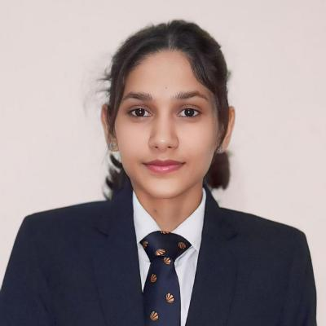


Prachi Gautam
Education
Masters of Computer Applications: 2023 – 2025
Bachelors of Computer Applications: 2019-2022
Analyst/Software Engineer
Base Location: Bangalore
Email ID: Prachi.a.gautam@capgemini.com
Mobile No: +91 8319113292
Grade: A4
Skills
Azure Fundaments | Cloud concepts IaaS, PaaS, SaaS, Public, Hybrid. Azure Portal, Resource groups, Azure Subscription.
Integration Tools | Service Bus, Storage Account, Azure Functions, Logic Apps, APIM, Event HUB
Storage Account | Containers, Blob Storage, Access Tiers, SAS, File Storages.
Logic Apps | Workflows, Conditions, Actions, Connectors, Integration, Scopes
Service Bus | Queue, Topics
API Management | Publish, secure and monitor APIs
Azure Functions | Serverless, event-driven code, Integrations.
Database | NoSQL Basics and MySQL
UI Tech | HTML5, CSS3,JavaScript, ES6
Tools | Git, Postman, Swagger
C# | C# Basics, OOPS, Generics, Collections, Exception Handling
ASP.NET | ASP.NET Core Basics, Model Binding, Dependency Injections, Entity Framework, JWT Authentication
Add On skills | Communication, Team management. Peer learning, Leadership
Strengths
Azure Integration Services and .Net Full Stack
Achievement
Employee Filter Processing System
Hands-on experience in designing and implementing integration solutions using Microsoft Azure. Proficient in utilizing Logic Apps for workflow automation, Azure Functions for serverless execution, and API Management for secure publishing and monitoring of APIs. Skilled in building event-driven and messaging-based architectures using Azure Service Bus, Storage Accounts, Event Grid, and Event Hubs to enable scalable and reliable communication across distributed systems.
Proficient in developing scalable and maintainable applications using .NET and ASP.NET Core Web API. Experienced with Entity Framework Core for data access, LINQ for querying and implementing RESTfull APIs with authentication and authorization using JWT, Identity and Role-Based Access Control. Used design patterns, repository and service layers, and integrating with SQL Server and Azure services for backend solutions.
Actively learning about Gen-AI and I did projects.
Good Communication skills in English, Hindi, and able to work actively with teams.
- Designed and deployed a Logic App to automatically filter employee data based on job profiles, routing relevant details to designated Blob Storage containers and Service Bus queues. Implemented robust error handling mechanisms and configured IP filtering for API Management, which securely receives employee data in JSON format and triggers the Logic App for further processing.
Crop Deal
Developed a scalable application using ASP.NET Core Web API and Entity Framework. Implemented role-based access with Identity and JWT, enabling Farmers to sell crops directly to the Dealers, eliminating the need for middleman and ensuring the Fair Pricing. Using a clean architecture with Repository and Service layers and Swagger for API documentation.
Symptom Checker
Developed an AI-powered web application that analyzes user symptoms to provide health suggestions and facilitate doctor appointments. Integrated GenAI for intelligent symptom interpretation with ASP.NET backend and Angular frontend.
Certifications
AZ-900: Microsoft Azure Fundamentals
Azure Serverless Functions and Logic Apps
Presentation Title | Author | Date © Capgemini 2017. All rights reserved | 1

